Slide 1
Face Detection Based Door Unlock System by IOT
Presented By
Vikash Mahato(16900317001)
Tamojit Saha(16900317002)
Tamal Mandal(16900317003)
Subhayan Bhowmick(16900317005)
Guided By
Prof. Partha Bannerjee

Slide 2
Contains:
Introduction
Internet Of Things
NodeMCU-ESP32
Camera Module-ESP32
Stepper Motor-SG90
Motor Driver-L298
How it Works
Working Diagram
Applications
Advantages
Disadvantages
Future Works
Conclusion

Slide 3
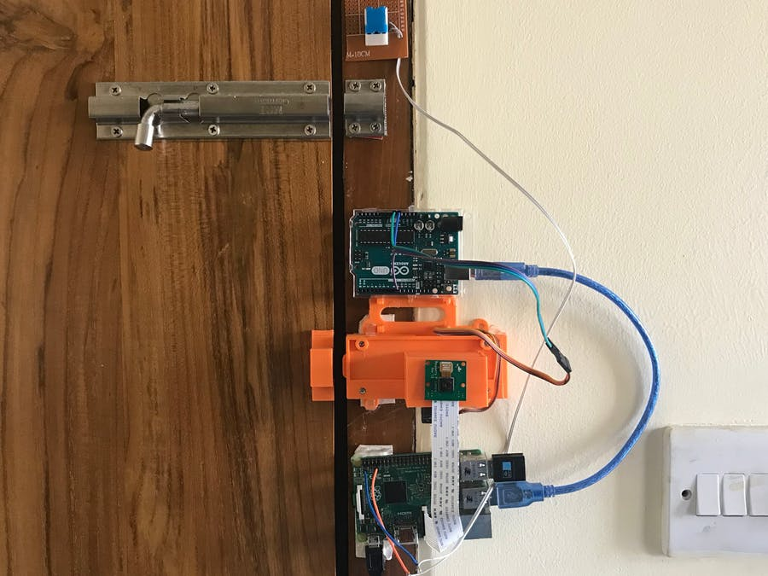
INTRODUCTION:
OBJECTIVE:
IOT based project
Home Automation Based Security System
Face Recognition Over Internet
More preferred in market nowadays.

Slide 4
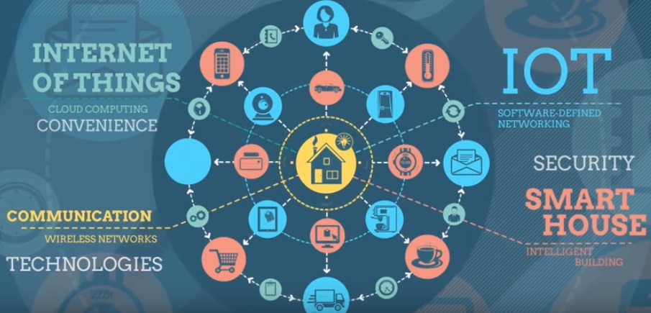
Internet Of Things:
SENSORS & ACTUATORS
CONNECTIVITY
PEOPLE & PROCESSES

Slide 5
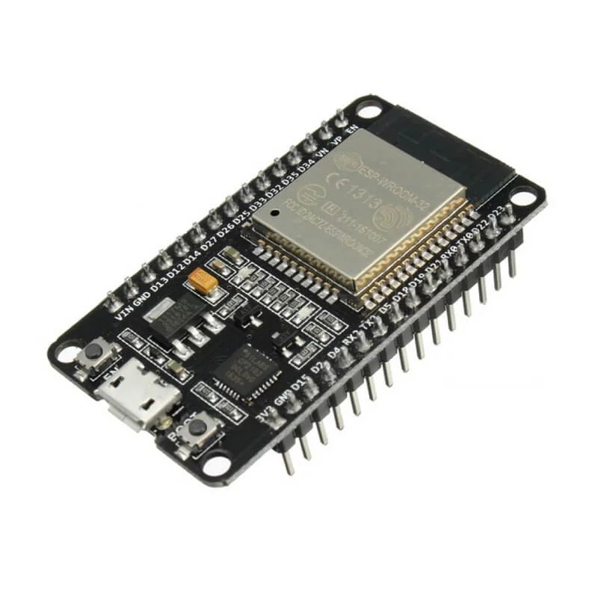
NODEMCU-ESP32:
A dual core 32-bit processor built-in 2.4 GHz Wi-Fi and Bluetooth
4MByte flash memory
520KByte RAM
Ultra-Low Power Consumption

Slide 6
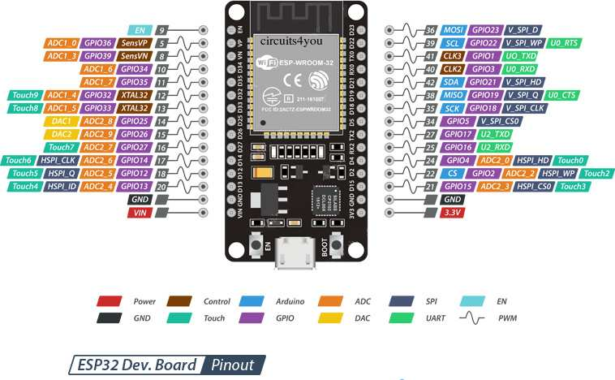
Pin Configuration:

Slide 7
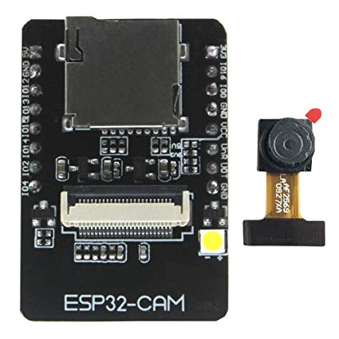
ESP32-CAM:
Low power 32-bit CPU
Up to 160MHz clock speed
Built-in 520 KB SRAM, external 4MPSRAM
Support OV2640 and OV7670 cameras, built-in flash lamp

Slide 8
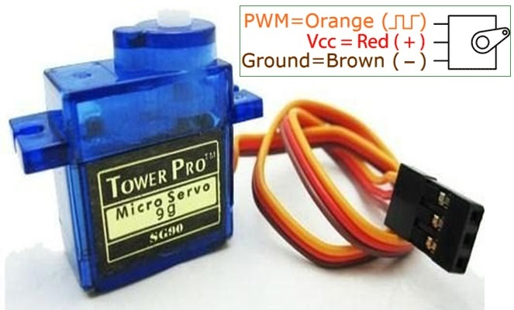
SG90 Servo Motor:
Operating Voltage +5V
Torque: 2.5kg/cm
Operating speed is 0.1s/60°

Slide 9
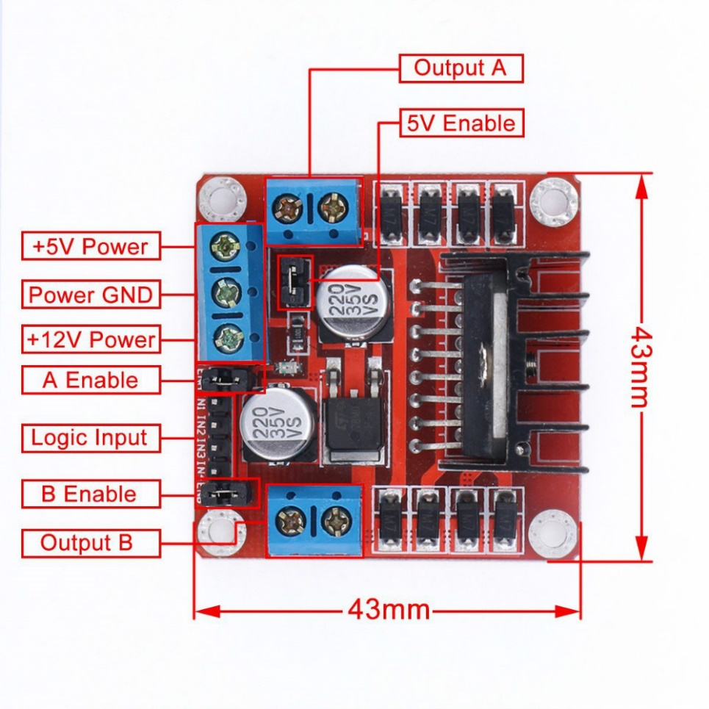
Motor Driver Module(L298):
Drive voltage: 5V-35V
Drive current: 2A
Weight: 26 gm

Slide 10
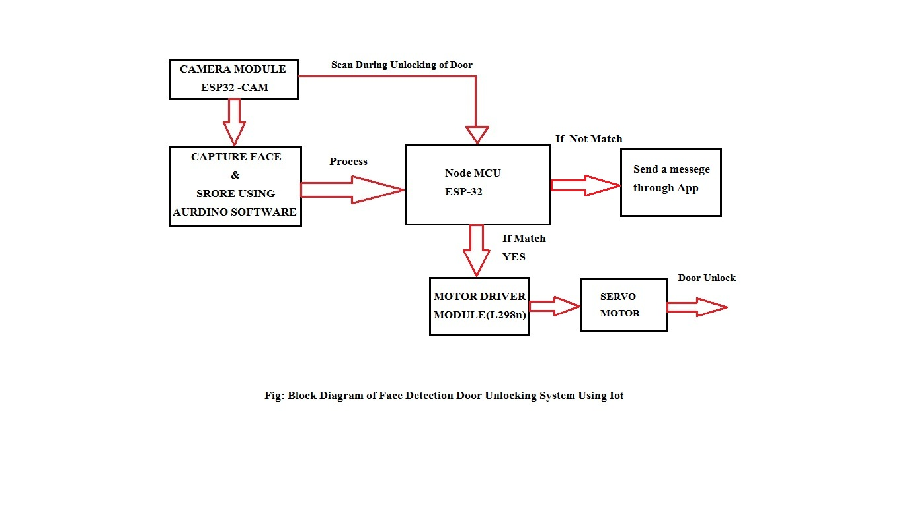
BLOCK DIAGRAM:

Slide 11
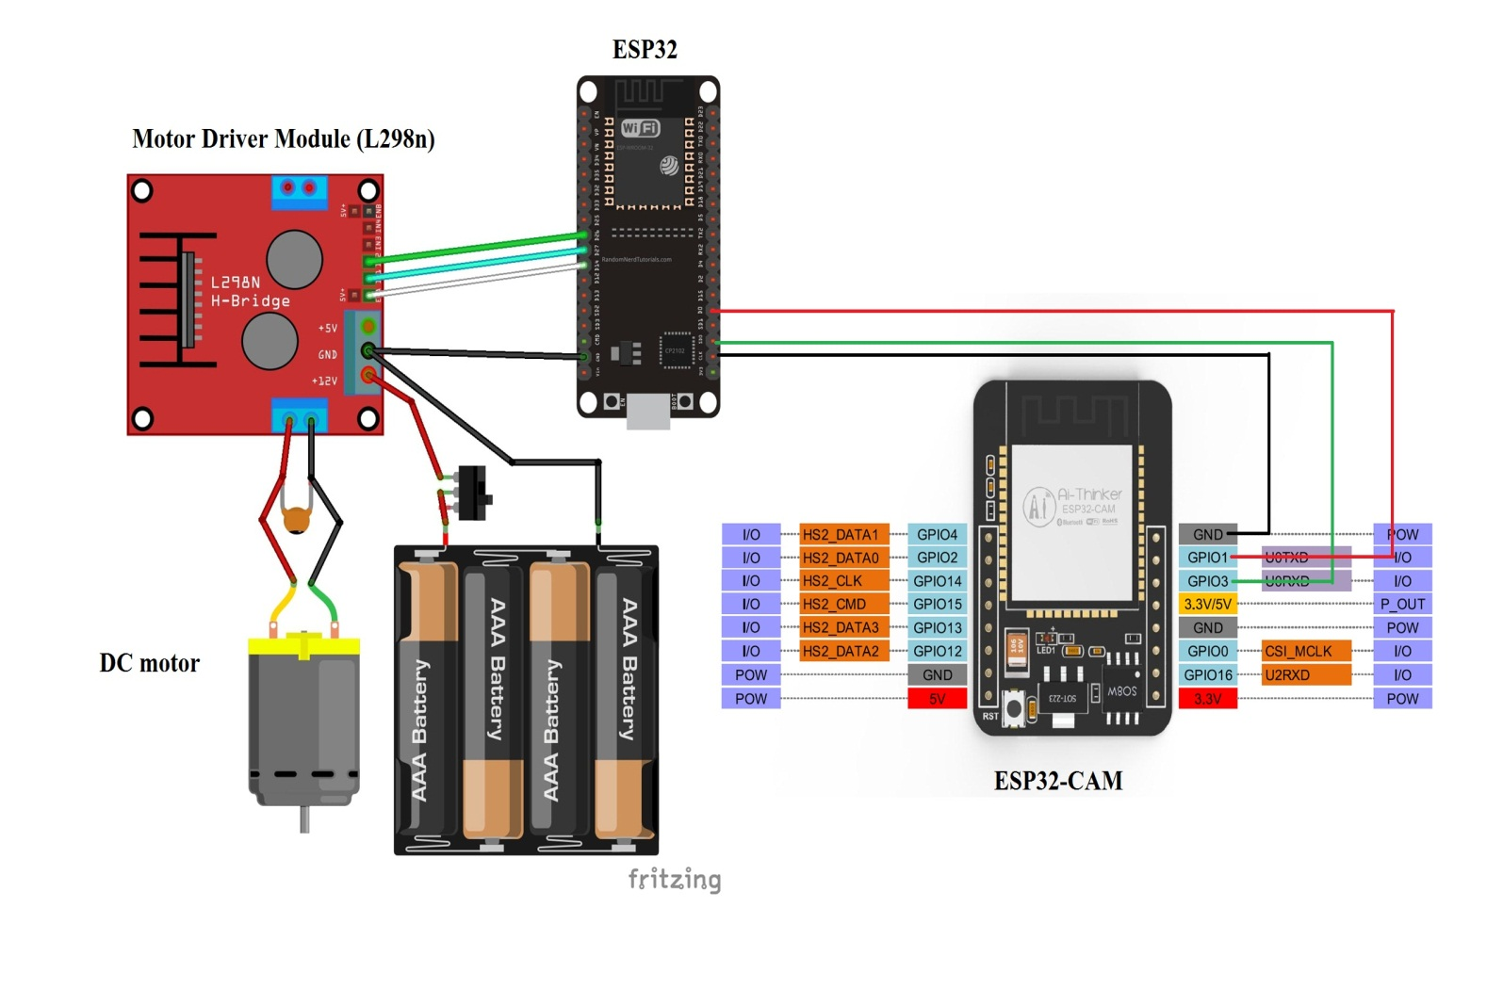
Circuit Diagram:

Slide 12
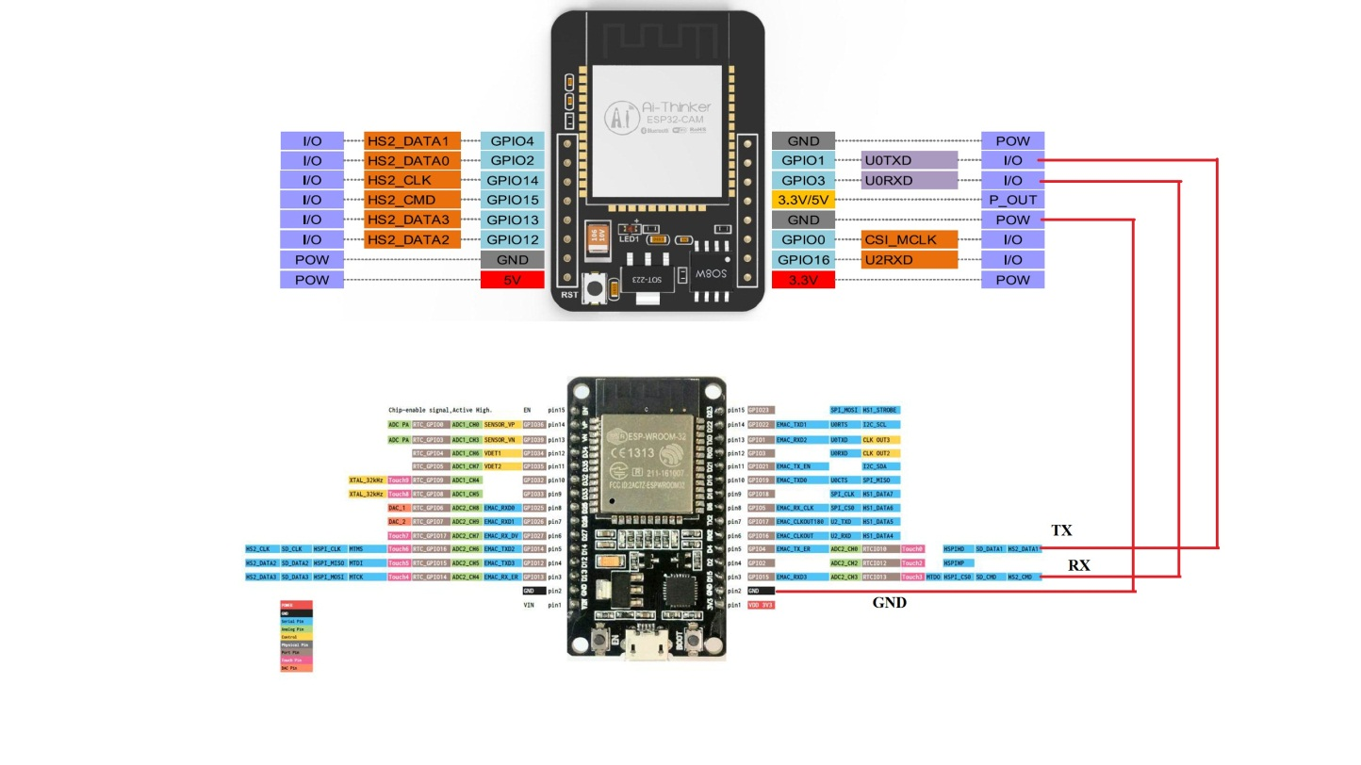

Slide 13
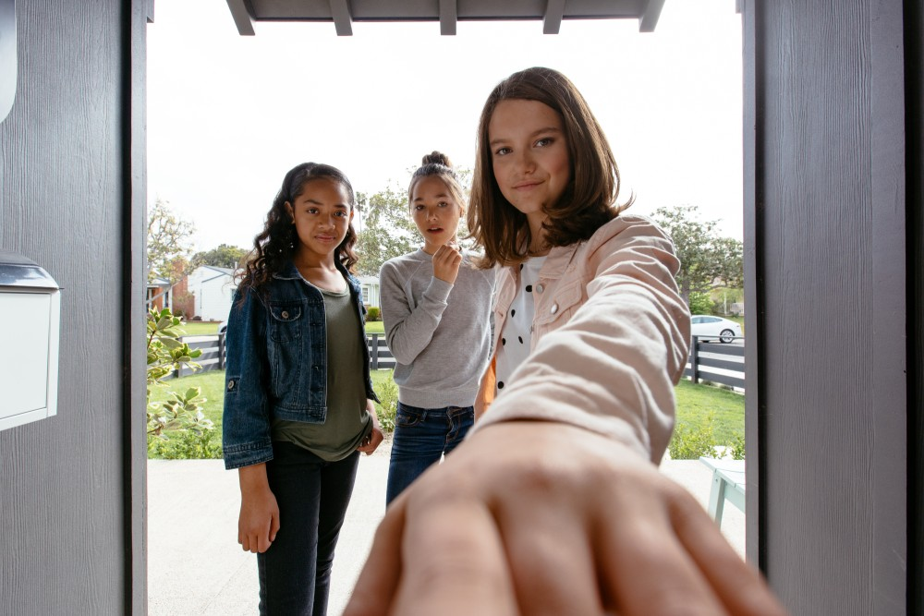
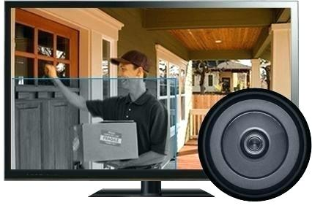
APPLICATIONS:
Automatic Access and security
Store multiple images in Database
Can Capture any unwanted things in front of door
Easily access from anywhere

Slide 14
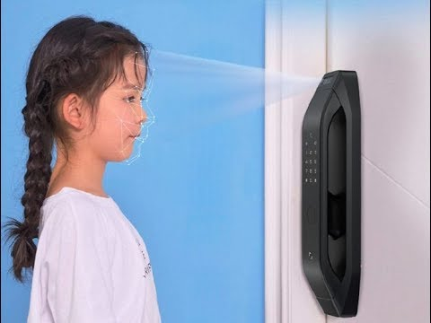
Advantages:
Improved Security
High Accuracy
Real Time Surveillance
Easy Integration Process
Cheaper than other conventional locks with such facilities
Nearly no false-positive face detection

Slide 15



Disadvantages:
Poor Internet Connection
Camera Angle
Power failure

Slide 16

FUTURE SCOPE:
Connect to cloud for storing video
Motion detection triggering mechanism
RFID Card based lock
AI based Face Detection Unlock

Slide 17
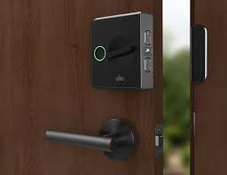
Conclusion:
Smaller, lighter and with lower power consumption
Cheaper than other security based systems with same features
Nearly no false-positive face detection

Slide 18
Bibliography:
https://www.espressif.com/en/products/hardware/esp32/overview
https://www.cytron.io/p-nodemcu-esp32
https://randomnerdtutorials.com/esp32-cam-video-streaming-face-recognition-arduino-ide/
https://www.electronics-lab.com/project/using-sg90-servo-motor-arduino/
https://www.instructables.com/id/ESP-32-Camera-Streaming-Video-Over-WiFi-Getting-St/

Slide 19
THANK YOU

